Slide 1

Travel Insurance
Marketing Strategy
Presentation to CEO on 2022.07.05

Slide 2
PRESENTATION AGENDAS
AGENDAS
1. Profile comparison between customers and non-customers.
2. Job sector & financial status comparison between customers and non-customers.
3. Travel signals and how it impact customers who have insurance.
4. Threats and opportunities for our company.
5. Executive summary

Slide 3
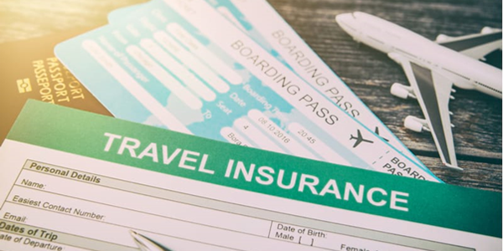


How are customers who purchase insurance different from those who haven’t in terms of Profile?
WHO ARE CUSTOMERS THAT BUY TRAVEL INSURANCE?
Customers who are First jobber/Middle age (AGE <=26 & AGE > 32)
Customers who have MID - LARGE family
Having CHRONIC DISEASES doesn’t increase the chance of customer buying travel insurance

Slide 4






Does Job sector/Financial status increase the chance of customers buying travel insurance?
Regardless if they graduated or not, those who went work for the private sector/self-employed are likely to buy travel insurance.
For those who work for the government sector, should select those who graduated to increases the chances of buying travel insurance.
As expected, people who buy travel insurance have high annual income (income > 1,200K)

Slide 5







Do Travel Signals increase the chance of customers buying travel insurance?
How can we personalize our messages to
retain this group of customers?
Color: % Have Insurance
Size of Bubble: #Have Insurance
From 298 customers who travel abroad and have insurance.
Now that we know customers who travel abroad
more than 70% of them purchase travel insurance.
First Jobber
( Age <=26)
Mid Size Family
( 4-5)
No Chronic diseases
Annual income around 1,200K- 1,400K
Graduated & Work for private sectors/self-employed

Slide 6


What are the Threats and Opportunities for our company?
In those who have insurance, 42% travel abroad followed by 34% who are frequent flyer.
What are Threats (T) for our company?
Customers who have travel insurance but haven’t show any sign of traveling recently.
What are Opportunities (O) for our company?
People who haven’t any insurance but travel a lot or went abroad.

Slide 7











Travel Insurance Executive Summary
• 710 Total Customers with Insurance
1,987 People from the Database
Customers who have insurance are usually first jobber or middle age
with mid to large size family.
This group is financially secure. They have high education
and they either work in private sectors or are self-employed.
ANNUAL INCOME
Higher Education & Work
HIGH
Annual income
> 1,200K
86%
Graduated
80%
Work for private sectors
77%
Have Mid/Large size family
LOW
Evidence suggests that customers who travel abroad
are likely to have insurance.
Must take action on customers who might not continue to purchase insurance and increase awareness to people who are potential buyers.
How can we retain travel abroad customers?
Threats
260 Opportunities
562 Threats
Profile & Demographics of travel abroad with insurance customers
78%
Travel Abroad
Customers who have travel insurance but haven’t show any sign of traveling recently.
People who haven’t any insurance but travel a lot or went abroad.
First
Jobber
4-5 Family
Size
No Chronic Disease
Ability to spend

